Slide 2

Distribution Management System
Group C003
Parag Jain
Nilesh Keshwani
Prachi Sankhala
R Soorya
Ritesh Jamunkar

Slide 3
Content
Problem Statement
Introduction
Technology Stack
Dependencies/Tools
Diagrams
Functionalities
Future Scope

Slide 4
Problem Statement
Develop system for inventory, purchase & user profile management for a telecom company.
Users: Admin, Distributor & Retailer.
Retailers & Distributors are mapped according to their area.
Inventory: E-top amounts, recharge coupon & sim card.

Slide 5

Introduction
DMS helps in purchase management, user profile management, inventory and stock management.
Mapping the distributors and retailers according to their area code.
Raise request for stock on distributor’s and retailer’s end.
Managing the offered inventory by the company.

Slide 6
Technology Stack
UI Design : Angular 8
Backend : JAVA EE, Spring Boot
Database : MySQL
Design : Bootstrap, Angular Material, CSS3

Slide 7
Dependencies/Tools
Maven
Spring Tools
Spring Security
Spring JPA
REST Services
Spring Eureka
Postman
JUnit

Slide 8
Diagrams
ER Diagram
Use Case Diagram
Activity Diagram
Sequence Diagram
Component Diagram

Slide 9
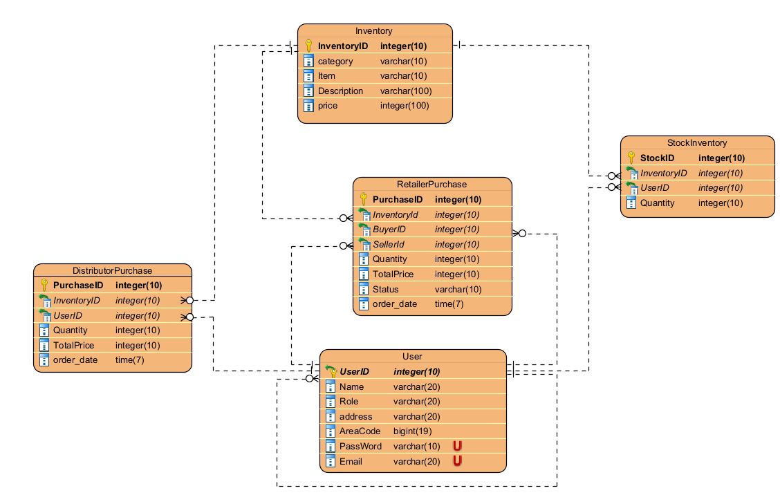
E-R Diagram

Slide 10
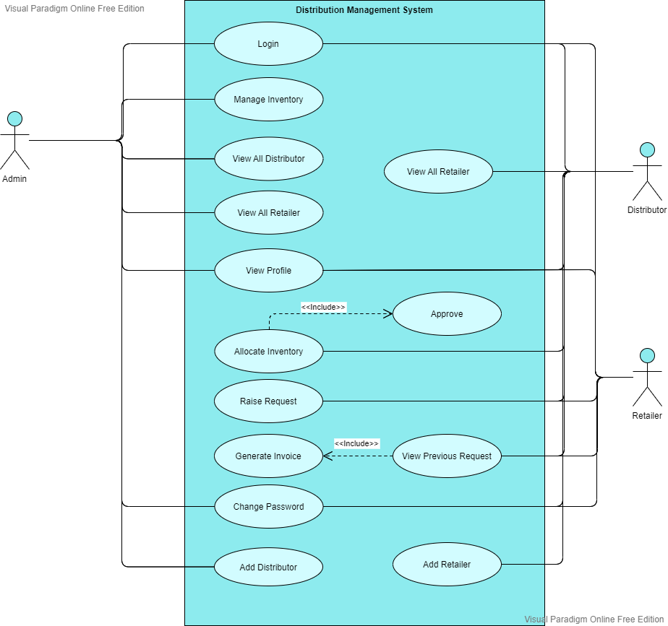
Use Case Diagram

Slide 11
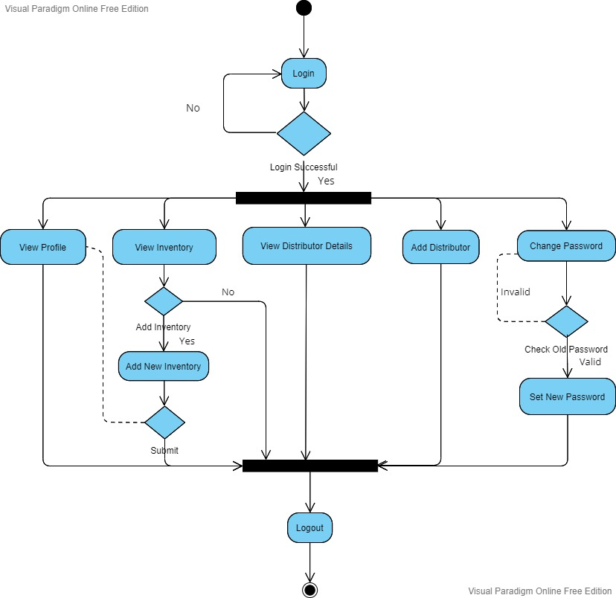
Activity Diagram: Admin

Slide 12
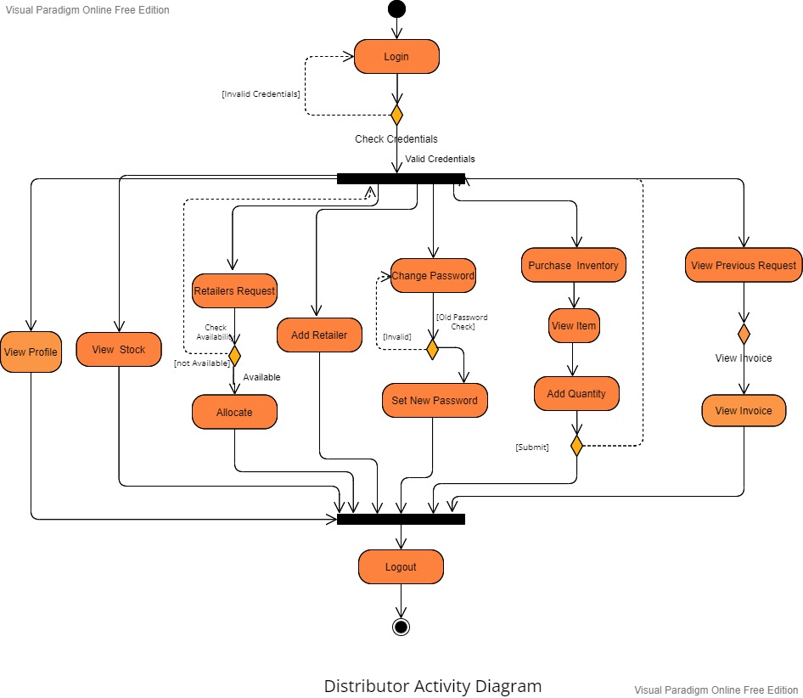
Activity Diagram: Distributor

Slide 13
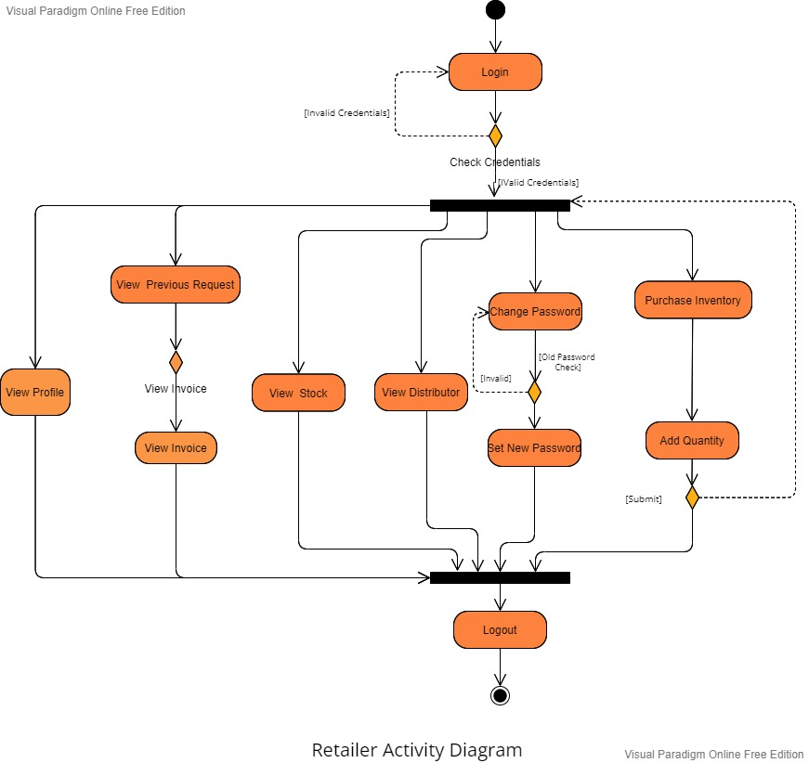
Activity Diagram: Retailer

Slide 14
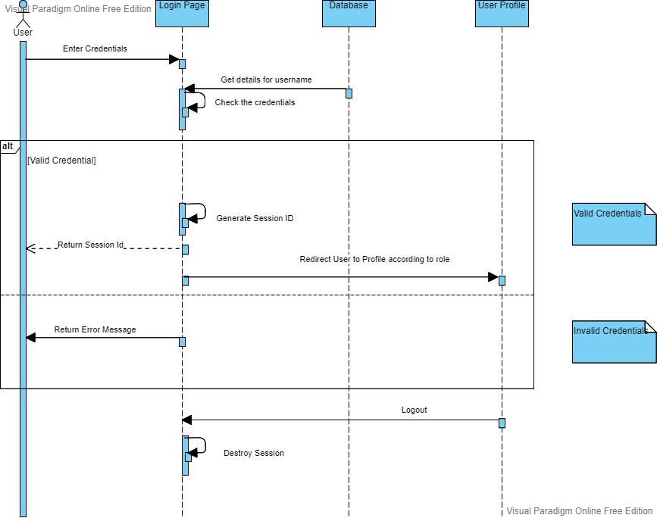
Sequence Diagram: Login Page

Slide 15
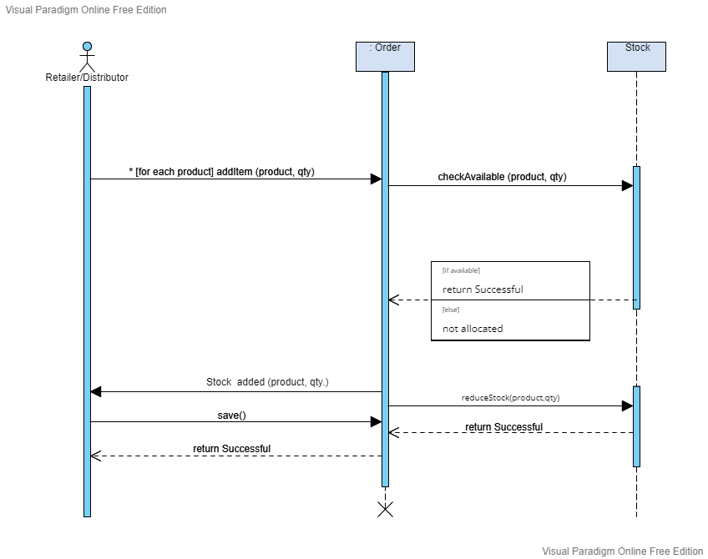
Sequence Diagram: Distributor/ Retailer Purchase

Slide 16
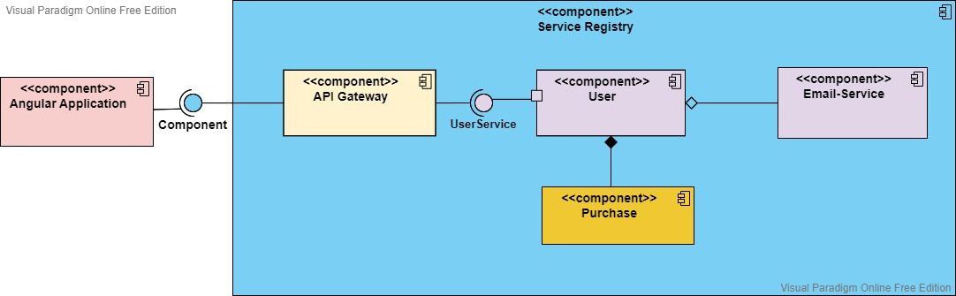
Component Diagram

Slide 17

Functionalities
User Login
Email Service
Inventory Management
Add Distributor or Retailer
Raise Purchase Order
Manage User Profile
Stock Management
Invoice Generation

Slide 18

Working

Slide 19
Future Scope
Adding Payment Gateway
Live Tracking of Purchase Order
Customer handling interface on retailer’s end.

Slide 20
THANK YOU

